Slide 1
Session 3
Using JSP Scriptlets

Slide 2
Session Objectives
Describe JSP tags in details
Define a JSP scriptlet
Explain the use of scriptlets in JavaServer Pages
Import a Java class
Describe the tag extension mechanism
Describe the JSP lifecycle

Slide 3

Introduction
The JSP 1.1 specification allows us to create custom tags
A user can define how the tag, its attributes, and its body are interpreted, and then group these tags into collections called tag libraries
Custom tags reduce the burden of JSP authors
A JSP file undergoes several changes till the response is sent back to the user – JSP lifecycle

Slide 4

JSP scriptlets revisited
An Example:
<%@ page import = "java.util.Date" %>
<% java.util.Date now = new java.util.Date(); %>
<HTML>...<BODY>
<B> The time now is: </B>
<%= now.getHours() %>: <%= now.getMinutes() %>:
<%= now.getSeconds() %>
</BODY>
</HTML>

Slide 5
Conditional statements
Another Example:
<HTML>
<HEAD> <TITLE> A Simple Counter </TITLE> </HEAD>
<BODY>
<%! int count = 0; %>
<% count = count + 1; %>
<B> This page has been accessed
<%= count %> time(s). </B>
</BODY>
</HTML>

Slide 6
Conditional statements – (1)
Same Example with ‘if’:
<HTML>...<BODY>
<%! int count=0; %>
<% count = count + 1; %>
<B> This page has been accessed <%= count %> time(s). </B>
<% if (count == 1) {
out.println("<B> Welcome, you are the first visitor to our
site. </B>");
} else {
out.println("<B> You are not the first visitor to our site.
</B>");
}
out.println("<B> Please do visit us again. Thank you! </B>");
%>
... </HTML>

Slide 7
Conditional statements – (2)
<% String browser = request.getHeader("User-Agent"); %>
<% if (browser.indexOf("4.") != -1) { %>
<B> You have a recent browser </B>
<% } else { %>
<% if (browser.indexOf("MSIE") != -1) { %>
<B> You do not have a recent version of IE browser.
Please upgrade. </B>
<% } else if (browser.indexOf("Mozilla") != -1) { %>
<B> You do not have a recent version of Netscape
Navigator. Please upgrade. <B>
<% } %>
<% } %>

Slide 8
Iterative statements
The ‘for’ loop:
<B> Using a loop in a scriptlet... </B> <BR> <BR>
<% for (int i = 0; i < 5; i++) {
out.println("<B> Welcome to our site! </B> <BR>");
} %>

Slide 9
Iterative statements – (1)
The ‘while’ loop:
<HTML>...<BODY>
<% java.util.Enumeration enum =
request.getHeaderNames(); %>
<B> Here are the names of the headers
that have been sent...
</B> <BR> <BR>
<% while (enum.hasMoreElements()) { %>
<%= enum.nextElement() %> <BR>
<% } %>
...</HTML>

Slide 10
Exception handling
Calculator.html
<HTML>...<BODY>
<FORM ACTION = "Calculator.jsp" METHOD = "GET">
<INPUT TYPE = "TEXT" NAME = "value1"> <BR>
<INPUT TYPE = "TEXT" NAME = "value2"> <BR>
<INPUT TYPE = "SUBMIT" NAME = "Calculate"
VALUE = "Calculate">
...</HTML>

Slide 11
Exception handling – (1)
Calculator.jsp
<HTML>
<BODY>
<% try { %>
<%= Integer.parseInt(request.getParameter("value1")) +
Integer.parseInt(request.getParameter("value2")) %>
<% } catch(NumberFormatException e) { %>
Please enter valid numbers only
<% } %>
</BODY>
</HTML>

Slide 12
Using methods
<%! String str = new String("Hello"); %>
<% char ch = str.charAt(0);
out.print("<B> The first character is: </B>" + ch); %>

Slide 13

The tag extension mechanism
The JSP 1.1 specifications introduced the ability to define new tags called custom tags.
A user can define how the tag, its attributes, and its body are interpreted, and then group these tags into collections called tag libraries.

Slide 14
The tag extension mechanism – (1)
In order to use custom JSP tags, three separate components need to be defined:
The tag handler class that defines the tag’s behavior.
The tag library descriptor file that maps the XML elements to the tag implementations.
The JSP file that uses the tag library.

Slide 15
The tag handler class
ShowDateTag.jsp
package examples;
import java.io.*;
import javax.servlet.jsp.*;
import javax.servlet.jsp.tagext.*;
public class ShowDateTag extends TagSupport {
private PageContext pageContext;
public int doStartTag() throws JspException {
try {
pageContext.getOut().write(" " + new java.util.Date());
}
catch(IOException i) {
throw new JspException(i.getMessage()); }
return SKIP_BODY; }

Slide 16
The tag handler class – (1)
public int doEndTag() throws JspException {
return EVAL_PAGE;
}
public void release() { }
public void setPageContext(PageContext page) {
this.pageContext = page;
}
}

Slide 17
The tag library descriptor file
Once a tag handler class is defined, the next task is to identify the class for the server and to associate it with a particular XML tag name.
This task is accomplished by means of a tag library descriptor file, that is, a TLD file.

Slide 18
The tag library descriptor file – (1)
A TLD File
<?xml version="1.0" encoding="ISO-8859-1" ?>
<!DOCTYPE taglib
PUBLIC "-//Sun Microsystems, Inc.//DTD JSP Tag Library 1.1//EN"
"http://java.sun.com/j2ee/dtds/web-jsptaglibrary_1_1.dtd">
<!-- a tag library descriptor -->
<taglib>
<tlibversion>1.0</tlibversion>
<jspversion>1.1</jspversion>
<shortname>simple</shortname>
<uri></uri>
<info>
A simple tag library for the examples
</info>

Slide 19
The tag library descriptor file – (1)
<tag>
<name>showDate</name>
<tagclass>examples.ShowDateTag</tagclass>
<bodycontent>EMPTY</bodycontent>
<info>Displays the current date</info>
</tag>
</taglib>

Slide 20
The tag library descriptor file – (2)
web.xml
<taglib>
<taglib-uri>
myown-taglib.tld
</taglib-uri>
<taglib-location>
/WEB-INF/jsptags/myown-taglib.tld
</taglib-location>
</taglib>

Slide 21
The JSP file
<HTML>
.
.
<BODY>
<%@ taglib uri = "myown-taglib.tld" prefix = "myTag" %>
<myTag:showDate/>
.
.
</HTML>

Slide 22
The Lifecycle of a JSP
The life cycle of a JSP begins with a servlet…
JavaServer
Page
compiled
Servlet
Then the
rest follows…

Slide 23
The Java Servlet Architecture
Servlet Architecture
javax.servlet
package
javax.servlet.http
package
Consists of generic interfaces and classes, implemented and extended by all servlets.
Contains classes that are extended when creating HTTP-specific servlets.

Slide 24
The Java Servlet Architecture – (1)
The javax.servlet.Servlet interface is at the heart of this architecture.
It provides the framework for all servlets.
It defines five methods – three of which are:
  init() method – initializes a servlet
  service() method – receives and responds to client requests
  destroy() method – performs the cleanup

Slide 25
The Java Servlet Architecture – (2)
javax.servlet.Servlet
javax.io.Serializable
javax.servlet.ServletConfig
javax.servlet.GenericServlet
javax.servlet.http.HttpServlet

Slide 26
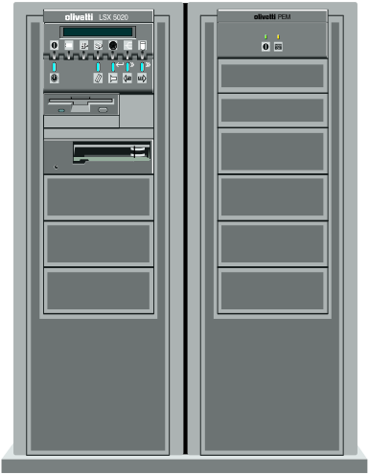
A GenericServlet request
Request
Client
GenericServlet
service()
Response

Slide 27
The Java Servlet Architecture – (3)
Web-based
applications
HttpServlet
Internet
Extends
Servlets
H T T P
protected void service(HttpServletRequest req, HttpServletResponse resp) throws ServletException, IOException

Slide 28
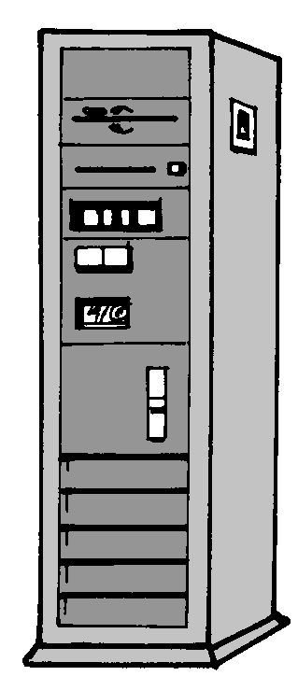
An HttpServlet request
service
doDelete()
doGet()
Request
doOptions()
Client
doPost()
Response
doPut()
doTrace()

Slide 29
The servlet lifecycle
1
Class Loaded
2
Instantiation
3
init()
4
service()
5
destroy()
Finalization and
Garbage Collection
6

Slide 30
HelloServlet.java
import javax.servlet.*;
import javax.servlet.http.*;
import java.io.*;
import java.util.*;
public class HelloServlet extends HttpServlet {
public void init(ServletConfig config) throws ServletException {
super.init(config);
}

Slide 31
HelloServlet.java – (1)
public void doGet(HttpServletRequest req, HttpServletResponse res)
throws ServletException, IOException {
res.setContentType("text/html");
PrintWriter out = res.getWriter();
out.println("<HTM L>");
out.println("<HEAD> <TITLE> Hello Servlet </TITLE> </HEAD>");
out.println("<BODY>");
// prints the REQUEST METHOD sent by the client
out.println("The requested method is:"+ req.getMethod()+ "<BR>");
out.println("</BODY> </HTML>");
out.close();
}
Process the HTTP GET request

Slide 32
HelloServlet.java – (2)
public void doPost(HttpServletRequest req, HttpServletResponse res)
throws ServletException, IOException {
res.setContentType("text/html");
PrintWriter out = res.getWriter();
out.println("<HTM L>");
out.println("<HEAD> <TITLE> Hello Servlet </TITLE> </HEAD>");
out.println("<BODY>");
// Prints the REQUEST METHOD sent by the client
out.println("The requested method is:"+ req.getMethod()+ "<BR>");
out.println("</BODY> </HTML>");
out.close();
}
}
Process the HTTP POST request

Slide 33
Two ways to invoke the servlet
Reference the servlet by naming it in the URL
http://serverIPAddress:port_number/servlet/HelloServlet
The request method is set to GET, by default.
1
Example:
http://10.1.1.246:8080/Aptech/servlet/HelloServlet
Working Directory

Slide 34
Two ways to invoke the servlet – (1)
Create an HTML page that will send a request to the servlet, using the POST method
2
<HTML>...
<FORM
ACTION = http://10.1.1.246:8080/Aptech/servlet/HelloServlet
METHOD = POST> <BR>
Click on <B>Submit Query</B> to launch the servlet <BR> <BR>
<INPUT TYPE = submit> <INPUT TYPE = reset>
</FORM>...
</HTML>
The HTML page

Slide 35
HelloServlet.java – (3)
HelloServlet.java overrides four methods:
init()
  Accepts a ServletConfig object as an argument
doGet()
  Handles all GET requests
doPost()
  Handles all POST requests

Slide 36
HelloServlet.java – (4)
getServletInfo()
  Used to provide
    the version,
    copyright,
    author,
    any other information about the application.

Slide 37
The JSP Lifecycle
JSP
Response
Object
JSP
Engine
Web
Client
Process
Web
Server

Slide 38

The JSP Lifecycle – (1)
The first time the engine receives a request for a JSP
Super class
specified by
the user
javax.servlet.
jsp.JspPage
Engine
Compiles
Class file

Slide 39
Some methods of javax.servlet.jsp.JspPage
Method
Usage
public void jspInit()
This is invoked when the JSP is initialized. This is similar to the init() method in servlets.
public void jspDestroy()
This is invoked when the JSP is about to be destroyed by the container. This is similar to the destroy() method in servlets.

Slide 40
A method of javax.servlet.jsp.HttpJspPage
Method
Usage
public void _jspService( HttpServletRequest req, HttpServletResponse res) throws ServletException, IOException
This method corresponds to the body of the JSP and is used for threaded request processing, like the service() method in servlets.
The implementation for this method is generated by the JSP container and should not be provided by developers of the JSPs.

Slide 41
The JSP Lifecycle – (2)
Initialization
public void jspInit()
Handling the client requests and generate the responses
void _jspService(ServletRequest, ServletResponse)
throws IOException, ServletException
Destroying the JSP page
public void jspDestroy()

Slide 42
A Simple JSP
<HTML>
<BODY>
<B> <% out.println("Hello World!"); %> </B>
</BODY>
</HTML>

Slide 43
The generated code
public void _jspService(HttpServletRequest request,
HttpServletResponse response)
throws IOException, ServletException {
. . .
// HTML// begin [file="C:\\HelloWorld.jsp";from=(0,0);to=(3,0)]
out.write("<HTML>\r\n<BODY>\r\n\r\n");
// end
// begin [file="C:\\HelloWorld.jsp";from=(3,2);to=(3,32)]
out.println("Hello World!");
// end
// HTML// begin [file="C:\\HelloWorld.jsp";from=(3,34);to=(6,7)]
out.write("\r\n\r\n</BODY>\r\n</HTML>");
// end

